Slide 1
Assignment ACA
Nhóm 2

Slide 2
Members
Bùi Đức Hiếu
Đoàn Dũ
Lê Nguyễn Khánh Duy
Lê Nguyên Dũng

Slide 3
Outline
Different between:
Data Cache and Instruction Cache
Unified Cache and split Cache
Multi-level Cache
What is cache performance?

Slide 4
This presentation focus on answer teacher's questions.
Answers are showed through inside contents.

Slide 5
Data cache and Instruction Cache

Slide 6
Data cache and Instruction Cache
First and probably foremost, data stored in instruction cache (i cache) is generally somewhat different than in data cache (d cache).

Slide 7
Data cache and Instruction Cache
Second, it simplifies circuitry a bit.
Data cache deal with reads and writes.
Instruction cache only deals with reads.

Slide 8
Data cache and Instruction Cache
Third, it increases bandwidth.
Modern processors can read data from i & d cache simultaneously so they can actually do two reads and one write in any given cycle.

Slide 9
Data cache and Instruction Cache
Fourth, it can save power.
Power down when the associated circuitry not used.
Separate caches can power up circuits to increasing the chances of a circuit remain un-powered.

Slide 10
Multi-level cache

Slide 11
Multi-level cache
A CPU cache is used to reduce the average time to access memory by processor.
The problem is the balance between latency and cache hit time.
Multi-level cache

Slide 12
Multi-level cache
Multi-level caches generally operate by checking the fastest cache L1 first.
Hit, the processor proceeds at high speed.
Miss, the next fastest cache (L2) is checked.
And so on before memory is checked.

Slide 13
L1 cache
The fastest cache, very very high speed.
It usually comes within the processor.
8-64kb (4 - 32kb).
Created by SRAM.
Seperated i & d cache.

Slide 14
L2 cache
Secondary cache
High speed, but slower then L1.
64kb - 4MB (512kb/1 core).
Between L1 and memory.
Not seperate i & d cache.

Slide 15
L3 cache
Extra cache.
Between L2 and memory.
Slower than L2, but higher then memory.
Share by all of core.
4 - 8 MB.

Slide 16
Multi level Cache:
Average Memory Access Time (AMAT)

Slide 17

AMAT
With cache L1 and L2

Slide 18
AMAT
Local miss rate = Miss rate (L1) hoặc Miss rate (L2)
Global miss rate = Number of miss/ total number of memory accesses = Miss rate (L1), but miss rate (L1) x Miss rate (L2)

Slide 19
Note
Như vậy, trong phần trên, nhóm 2 đã trả lời 3 câu hỏi:
Tại sao lại có multi-cache?
Sự khác nhau của các loại cache L1, L2, L3?
Công thức tính AMAT cho mỗi loại cache?

Slide 20
L4 Cache?
Multilevel cache is the compromise of multi processor and cost, performance.
Each core read/write with its own L1.
L2 is shared by cores.

Slide 21
L4 Cache?
L1, L2, L3 are created by SRAM.
SRAM is very expensive.
L2 stores frequently data.
L3 stores less frequently data.

Slide 22
What is cache performance?

Slide 23
What is cache performance?
Instruction count (IC) is independent of the hardware.
Miss rate is independent of the speed of the hardware.
Miss rate can be just as misleading as instruction count.

Slide 24
What is cache performance?
Better measure of memory hierarchy performance is average memory access time (AMAT).
AMAT = Hit time + Miss rate x Miss penalty
This formula can help us decide between split caches and a unified cache.

Slide 25
What is cache performance?
The performance, including cache misses
Performance using miss rate

Slide 26
Example
Assume that the cache miss penalty is 200 clock cycles, and all instructions normally take 1.0 clock cycles (ignoring memory stalls). Assume that the average miss rate is 2%, there is an average of 1.5 memory references per instruction, and the average number of cache misses per 1000 instructions is 30. What is the impact on performance when behavior of the cache is included? Calculate the impact using both misses per instruction and miss rate.

Slide 27
Answer
The performance, including cache misses
CPU time = IC ×[1.0 + (30/1000 ×200)]
Clock cycle time
= IC ×7.00 ×Clock cycle time
The performance using miss rate
CPU time = IC ×[1.0 + (1.5 ×2% ×200)]
Clock cycle time
= IC ×7.00 ×Clock cycle time

Slide 28
Effects of Cache Performance on CPU performance

Slide 29
Effects of Cache Performance on CPU Performance
Low CPI machines suffer more relative to some fixed CPI memory penalty.
A machine with a CPI of 5 suffers little from a 1 CPI penalty.
However, a processor with a CPI of 0.5 has its execution time tripled.

Slide 30
Effects of Cache Performance on CPU Performance
Cache miss penalties are measured in cycles, not nanoseconds.
A faster machine will stall more cycles on the same memory system.

Slide 31
Improving Cache Performance

Slide 32
Improving Cache Performance
Reducing the miss rate: larger block size, larger cache size, and higher associativity.
Reducing the miss penalty: multilevel caches and giving reads priority over writes.
Reducing the time to hit in the cache.

Slide 33
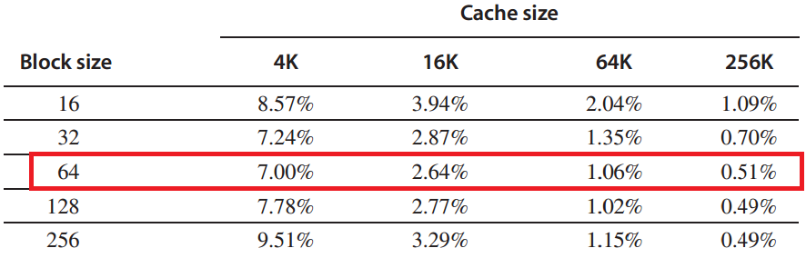
Improving Cache Performance
Reducing Miss Rate: larger block size, larger cache size.
Increasing block size up to 64-byte since when increasing block size up to 128-byte, the miss rate is increasing again.

Slide 34
Improving Cache Performance
Reducing Miss Rate: higher associativity.
Reduce conflict misses.
Rules of thumb
  8-way = fully associative
  Direct mapped size N=2-way set associative N /2

Slide 35
Improving Cache Performance
But
Size N associative is larger than Size N direct mapped.
Associative typically slower that direct mapped.

Slide 36
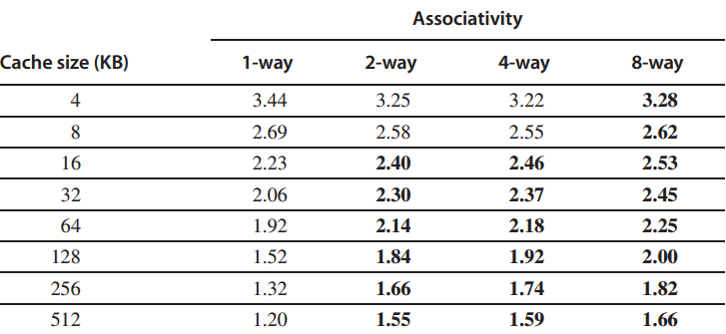
Improving Cache Performance

Slide 37
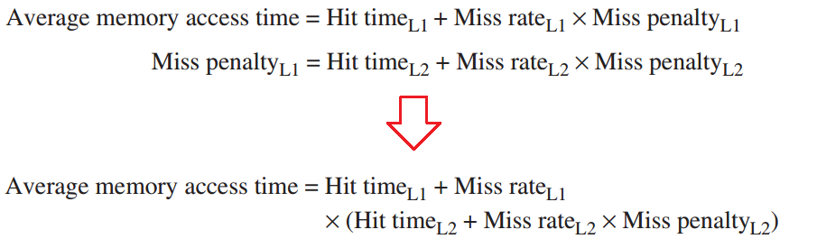
Improving Cache Performance
Reducing Miss Penalty: Multilevel cache

Slide 38
Improving Cache Performance
Reducing Miss Penalty: Giving Priority to Read Misses over Writes.
This optimization serves reads before writes have been completed.

Slide 39
Improving Cache Performance
With the complexities of a write buffer:
With a write-through cache, write buffer of the proper size is the most important improvement.
Write buffers do complicate memory accesses since they might hold the updated value of a location needed on a read miss.

Slide 40
Improving Cache Performance
Reducing the time to hit in the cache
Make Caches smaller and simpler
Hit Time = 1 cycle is good.
Smaller blocks.

Slide 41
Improving Cache Performance
For writes:
No write allocate: no “hit” on cache, just write to write buffer.
Write allocate: to avoid two cycles (first check for hit, then write) pipeline writes via a delayed write buffer to cache.

Slide 42
Improving Cache Performance
Summary
Hit time depends on cache size.
Cache is larger => hit time is increased => miss rate is decreased.
We cannot reduce all of components: miss rate, miss penalty, hit time at the same time.

Slide 43
Unified and split cache

Slide 44
Unified and split cache
Proc
Proc
I-Cache-1
Proc
D-Cache-1
Unified
Cache-1
Unified
Cache-2
Unified
Cache-2

Slide 45
Unified and split cache
  Unified Cache
  Low Miss ratio because more space available for either instruction or data.
  Low cache bandwidth because instruction and data cannot be read at the same time due to one port.

Slide 46
Unified and split cache
  Split Cache
  High miss ratio because either instructions or data may run out of space even though space is available at other cache.
  High bandwidth because an instruction and data can be accessed at the same time.

Slide 47
Example
16KB I&D:
Inst miss rate=0.64%,
Data miss rate=6.47%
32KB unified:
Aggregate miss rate=1.99%
Which is better (ignore L2 cache)?

Slide 48
Answer
Assume 33% data ops ⇒ 75% accesses from instructions (1.0/1.33)
Hit time=1, miss time=50
Note that data hit has 1 stall for unified cache (only one port)
AMAT_{Harvard}=75%x(1+0.64%x50)+25%x(1+6.47%x50) = 2.05
AMAT_{Unified}=75%x(1+1.99%x50)+25%x(1+1+1.99%x50)= 2.24

Slide 49
Q & A

Slide 50
Thank you for attention.

